Slide 1

Industry Project Presentation
By
Name: Manya Tripathi (20162121009)
Institute of Computer Technology, Ganpat University
Date: 11-05-2024

Slide 2
Table of Contents
Objectives
Tools & Technology
Screenshots
References

Slide 3

Introduction to Project
"Educational Performance Prediction using Student Data" employs a data-driven approach to forecast academic outcomes. The project aims to develop a compact, user-friendly predictive model, enhancing early intervention strategies for educators. System requirements include high-performance servers, robust databases, and essential software tools. By leveraging technology and data analytics, the project seeks to empower educators with actionable insights, fostering a more effective learning environment and boosting student success rates. This initiative reflects a critical step towards personalized education and improved academic outcomes.

Slide 4
Objectives
Task 1 - Create a Word to CSV converter using –
Frontend using React
Python using Flask
Task 2- Create a Career Prediction Project –
Predict career options for the students after 12th using Machine Learning

Slide 5
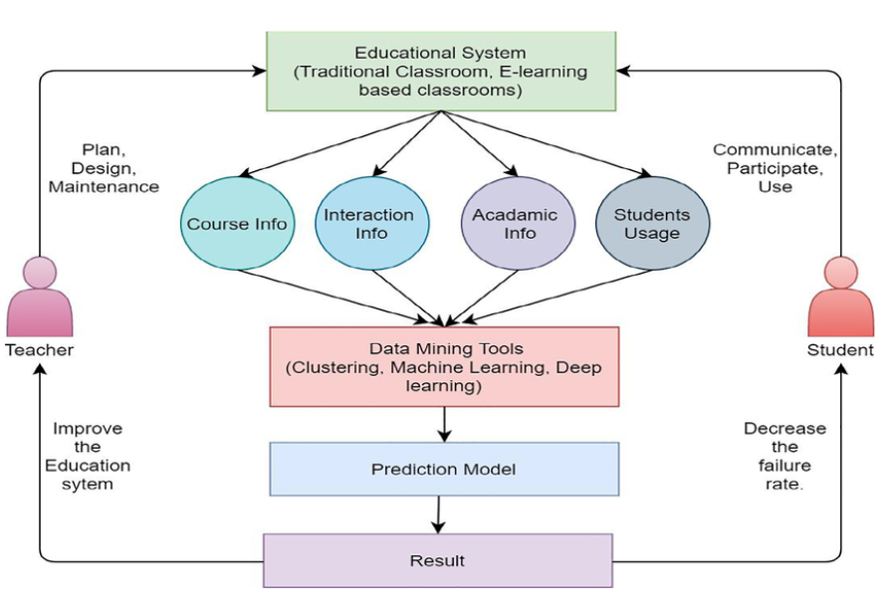
Methodology Used
1. Data Collection and Integration
2. Data Preprocessing
3. Development of Predictive Model
4. User Interface Design
5. System Implementation
6. Model Evaluation
7. Ethical Considerations
8. Scalability and Adaptability

Slide 6
Tools and Technology
Word to CSV converter –
Frontend – React
Backend – Python + Flask
Career Prediction –
Frontend - React
Backend – Python
Database – Firebase Firestore

Slide 7
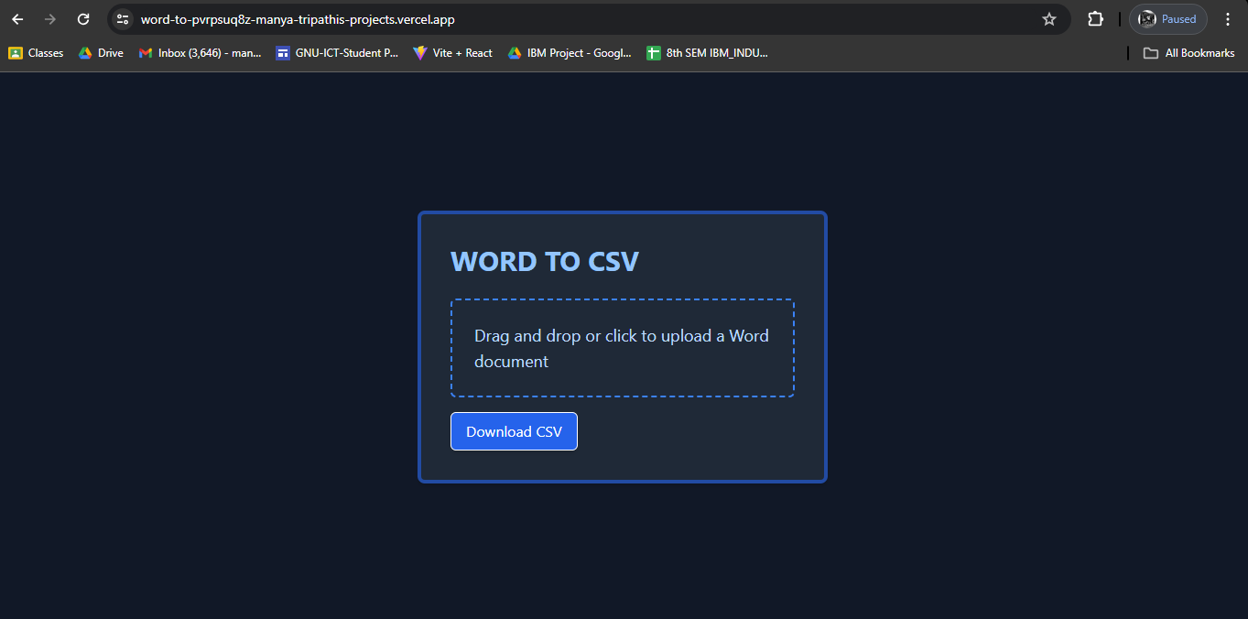
Screenshots
Task - 1 :

Slide 8
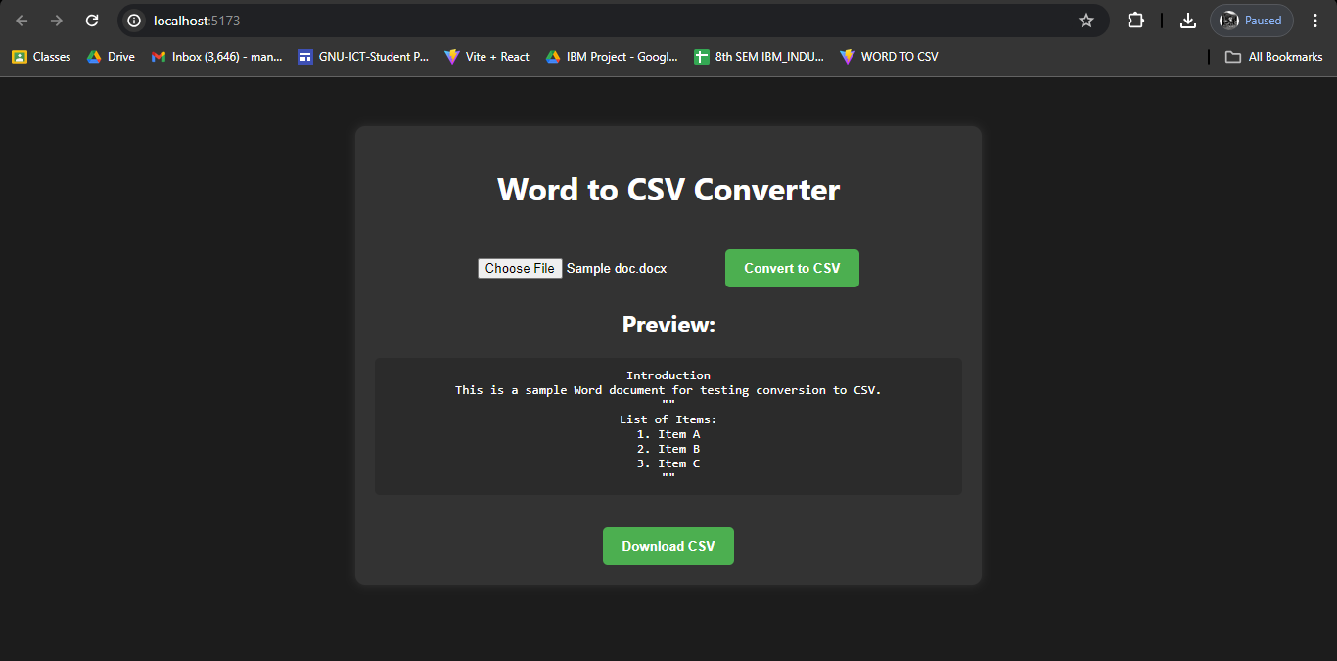
Converter 2 -

Slide 9
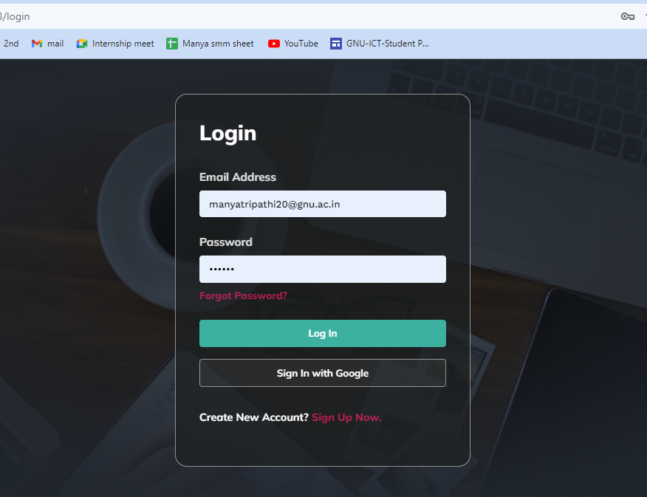
Task 2 : Career Options Prediction
Login Page

Slide 10

Signup

Slide 11
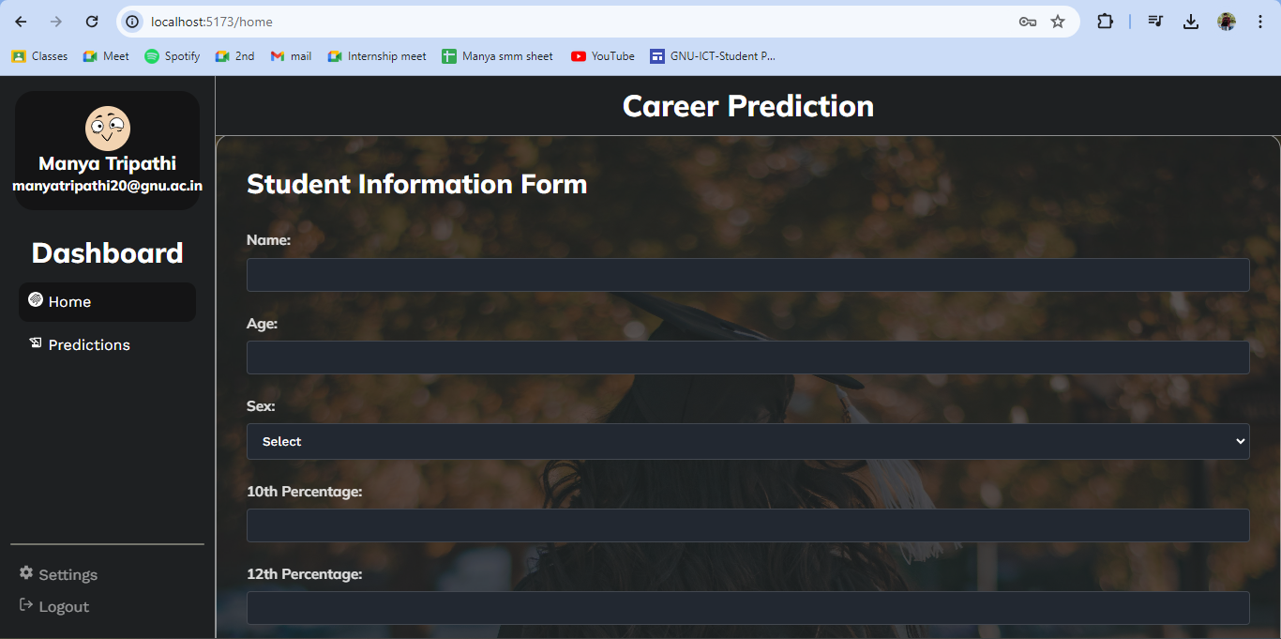
Dashboard

Slide 12
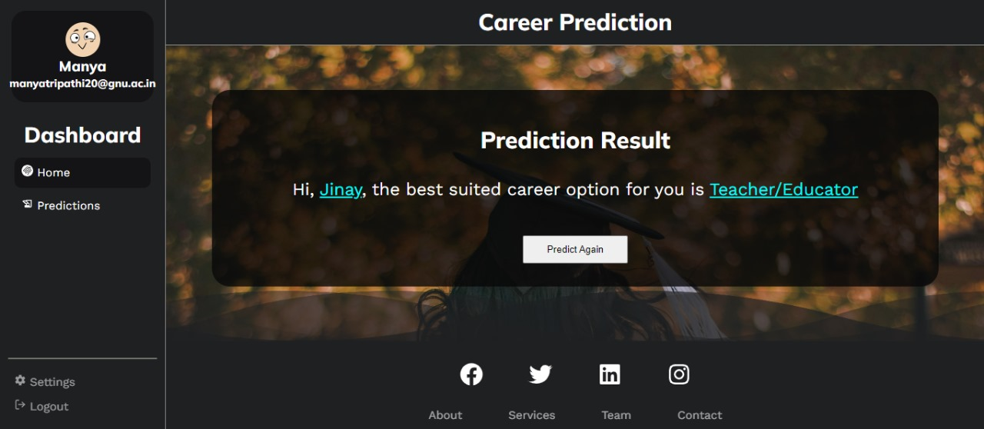
Prediction

Slide 13
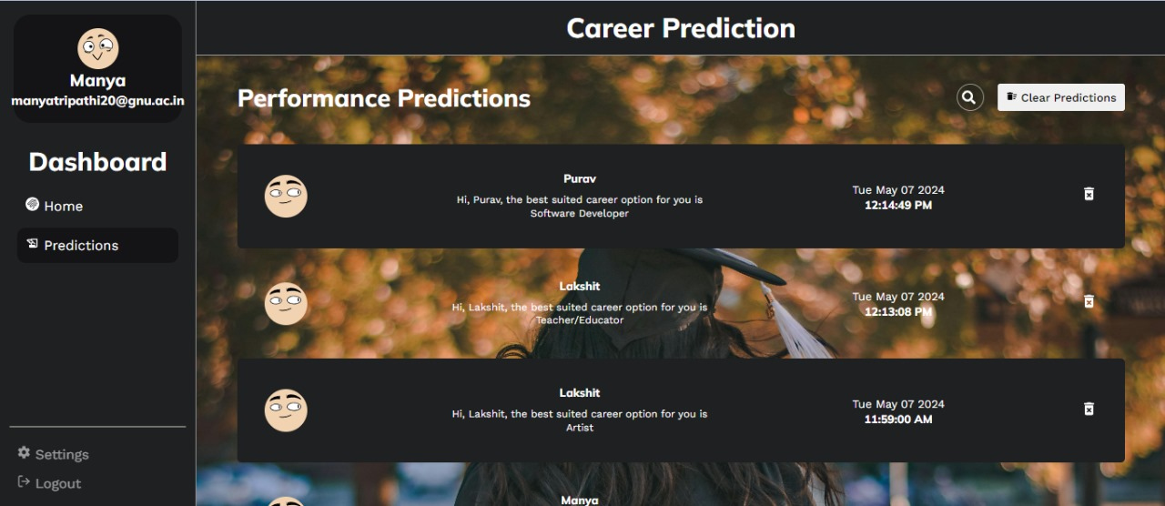

Slide 14
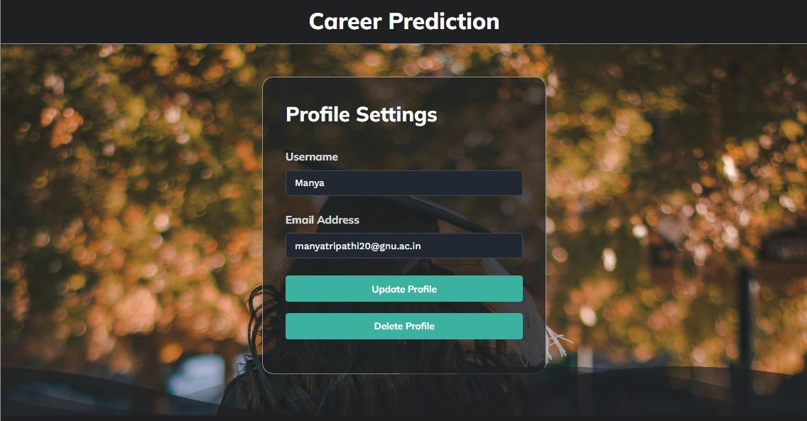
Profile

Slide 15
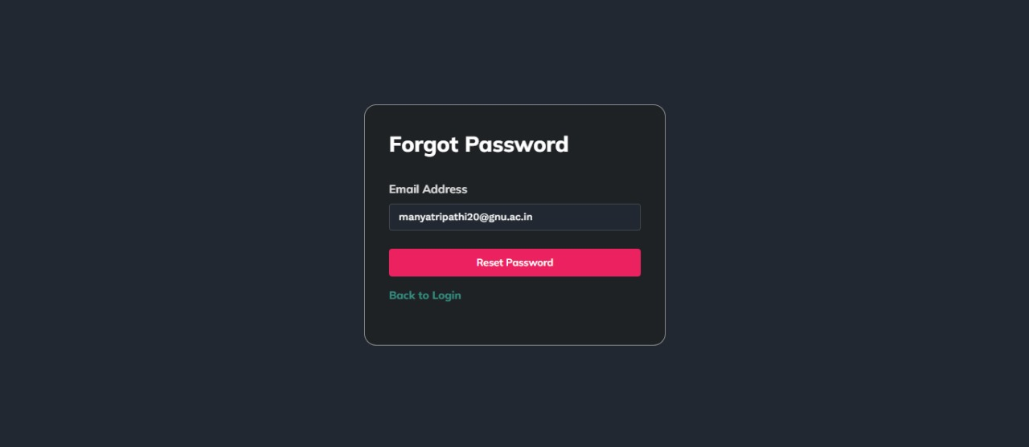

Slide 16
References
https://www.w3schools.com/
https://www.youtube.com/

Slide 17
Thank You !!

